Slide 1
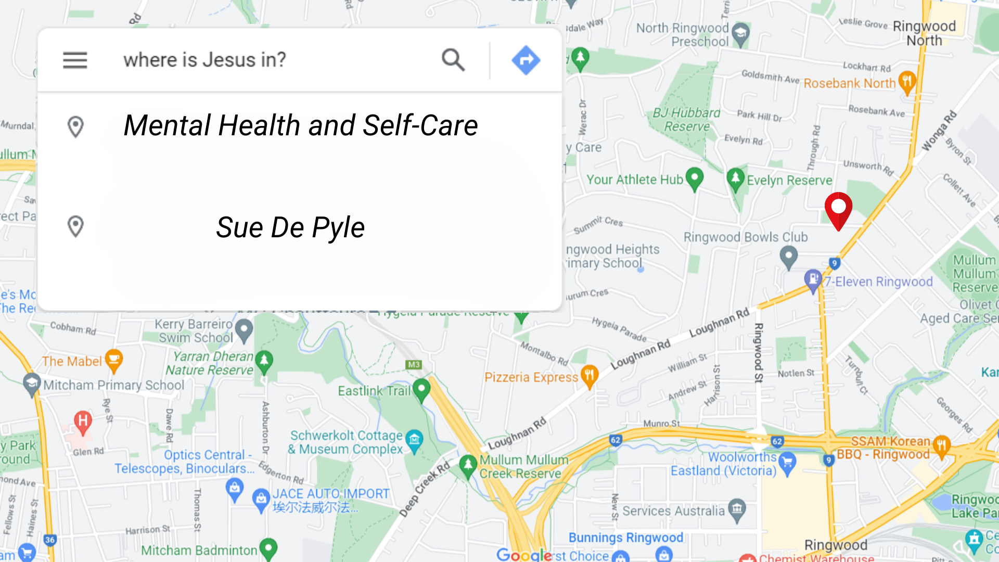

Slide 2
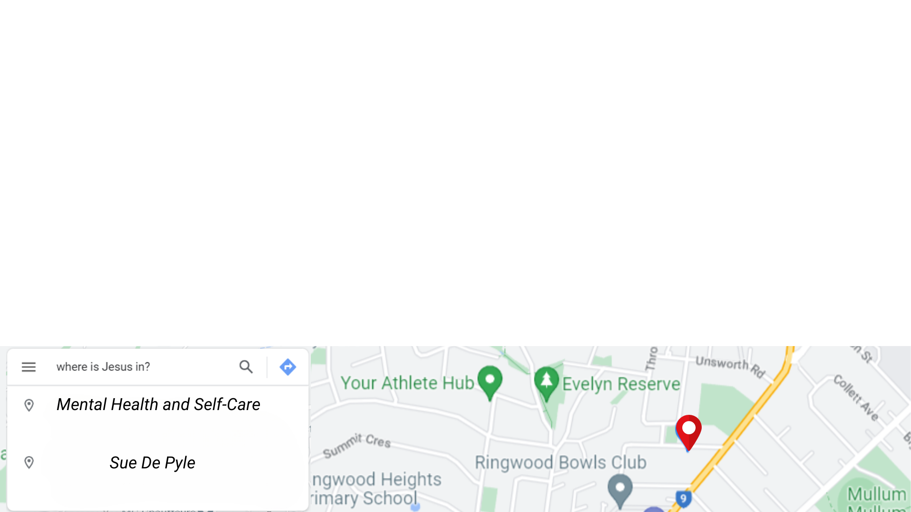
Some Important Points…
Not a Psychologist or Counsellor
Not a medical professional
One unit in Adolescent Counselling
Mental Health First Aid
Based on research, professional development, experience in education

Slide 3
Statistics about Mental Health in Australia
44% of Australians between 16 & 85 are expected to have experienced a mental disorder in their lifetime.
Over 20% experienced a mental disorder in the previous 12 months.
Most common Anxiety, followed by Depression and Substance abuse disorders.

Slide 5
Matthew 26:36-46
36 Then Jesus went with his disciples to a place called Gethsemane, and he said to them, “Sit here while I go over there and pray.” 37 He took Peter and the two sons of Zebedee along with him, and he began to be sorrowful and troubled.

Slide 6
Matthew 26:36-46
38 Then he said to them, “My soul is overwhelmed with sorrow to the point of death. Stay here and keep watch with me.” 39 Going a little farther, he fell with his face to the ground and prayed, “My Father, if it is possible, may this cup be taken from me. Yet not as I will, but as you will.”

Slide 7
Philippians 4:4-9
4 Rejoice in the Lord always. I will say it again: Rejoice! 5 Let your gentleness be evident to all. The Lord is near. 6 Do not be anxious about anything, but in every situation, by prayer and petition, with thanksgiving, present your requests to God. 7 And the peace of God, which transcends all understanding, will guard your hearts and your minds in Christ Jesus.

Slide 8
Philippians 4:4-9
4 Rejoice in the Lord always. I will say it again: Rejoice! 5 Let your gentleness be evident to all. The Lord is near. 6 Do not be anxious about anything, but in every situation, by prayer and petition, with thanksgiving, present your requests to God. 7 And the peace of God, which transcends all understanding, will guard your hearts and your minds in Christ Jesus.

Slide 9
Philippians 4:4-9
4 Rejoice in the Lord always. I will say it again: Rejoice! 5 Let your gentleness be evident to all. The Lord is near. 6 Do not be anxious about anything, but in every situation, by prayer and petition, with thanksgiving, present your requests to God. 7 And the peace of God, which transcends all understanding, will guard your hearts and your minds in Christ Jesus.

Slide 10
Philippians 4:4-9
4 Rejoice in the Lord always. I will say it again: Rejoice! 5 Let your gentleness be evident to all. The Lord is near. 6 Do not be anxious about anything, but in every situation, by prayer and petition, with thanksgiving, present your requests to God. 7 And the peace of God, which transcends all understanding, will guard your hearts and your minds in Christ Jesus.

Slide 11
Philippians 4:4-9
4 Rejoice in the Lord always. I will say it again: Rejoice! 5 Let your gentleness be evident to all. The Lord is near. 6 Do not be anxious about anything, but in every situation, by prayer and petition, with thanksgiving, present your requests to God. 7 And the peace of God, which transcends all understanding, will guard your hearts and your minds in Christ Jesus.

Slide 12
Philippians 4:4-9
4 Rejoice in the Lord always. I will say it again: Rejoice! 5 Let your gentleness be evident to all. The Lord is near. 6 Do not be anxious about anything, but in every situation, by prayer and petition, with thanksgiving, present your requests to God. 7 And the peace of God, which transcends all understanding, will guard your hearts and your minds in Christ Jesus.

Slide 14
Philippians 4:4-9
8 Finally, brothers and sisters, whatever is true, whatever is noble, whatever is right, whatever is pure, whatever is lovely, whatever is admirable—if anything is excellent or praiseworthy—think about such things. 9 Whatever you have learned or received or heard from me, or seen in me—put it into practice. And the God of peace will be with you.

Slide 15
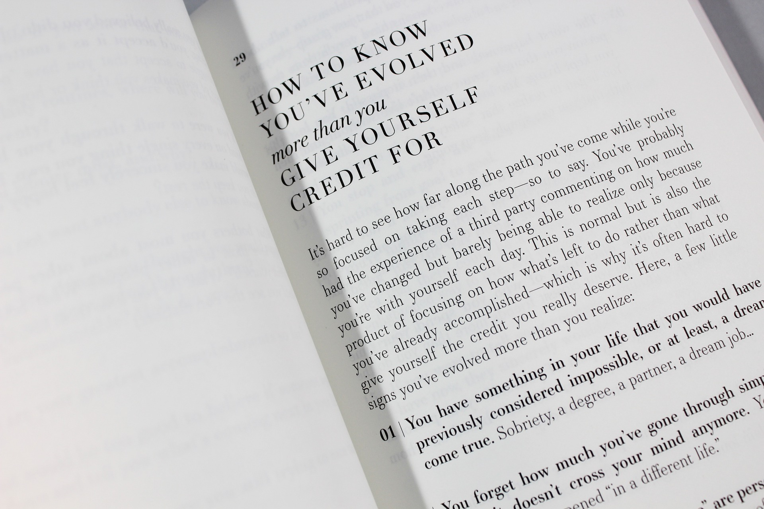
Self-Help
Industry

Slide 16
Helpful Tips…
Get exercise
Eat well
Ensure we have enough sleep
Talk with a good Psychologist or Counsellor
Practise gaining control over our thoughts
Limit social media

Slide 17
Helpful Tips continued…
Pray and hand our concerns over to God
Consider all the things God has done for us
Be still and know that I am God - Psalm 46 (June 13, 2021)
Live in community
Meditate on God’s word - Lectio 365

Slide 18
Some useful phone numbers (in Australia)
Lifeline - 13 11 14
Emergency - 000
Beyond Blue - 1300 22 4636
Kids Helpline - 1800 55 1800

